Slide 1


Slide 3

●
○
○
●
○

Slide 5
Open Jupyter in CloudxLab’s “My Lab”
●
●
git clone https://github.com/cloudxlab/ml.git
●
cd ml && git pull origin master
●
machine_learning/end_to_end_project_bootcamp.ipynb
Goto Files

Slide 6



Slide 8
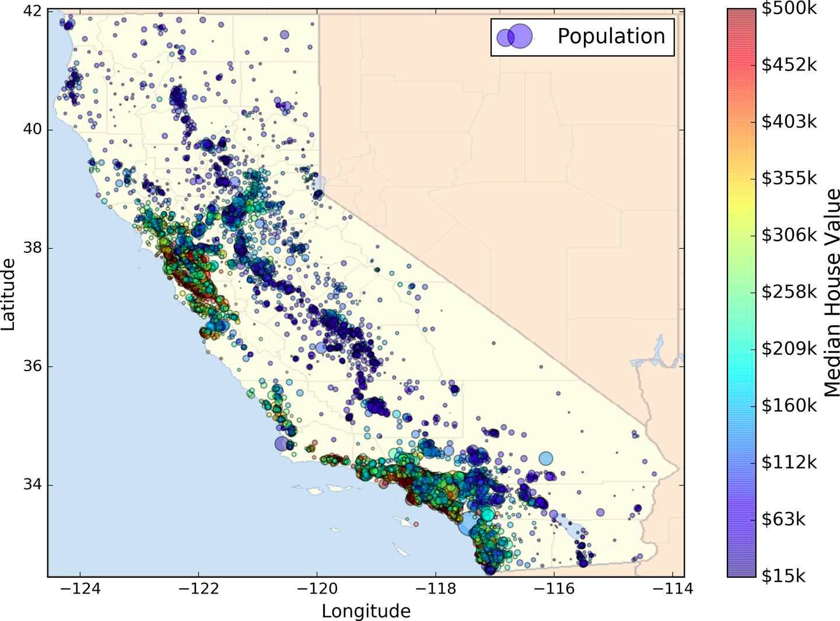

Slide 9
>>> | import | pandas | as | pd
>>> | import | os
>>> HOUSING_PATH = 'datasets/housing/'
>>> def load_housing_data(housing_path=HOUSING_PATH): csv_path = os.path.join(housing_path,
"housing.csv")
return pd.read_csv(csv_path)
>>> housing = load_housing_data()
>>> housing.head()
Run this in notebook

Slide 11


●
○
○
○
○

Slide 12

●
●
●

Slide 14
●
●
●
○
○
○
○

Slide 15
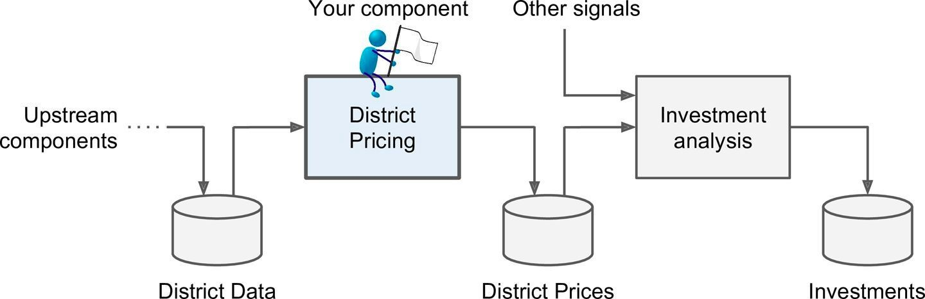

Slide 16
●
○
●
○
○
○

Slide 17
●
●

Slide 18
●
○
○
○
○
○

Slide 19

●

Slide 20



○
○
○
○
○

Slide 21
●
●
●

Slide 22
●
●
○

Slide 24

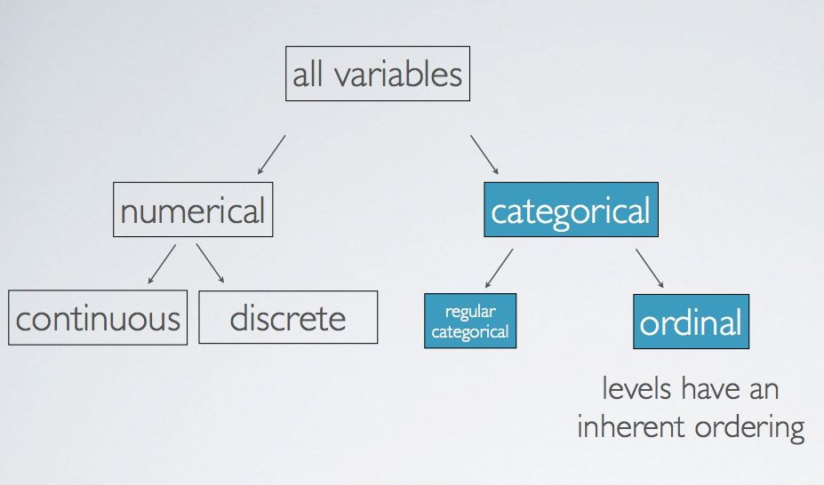

Slide 25
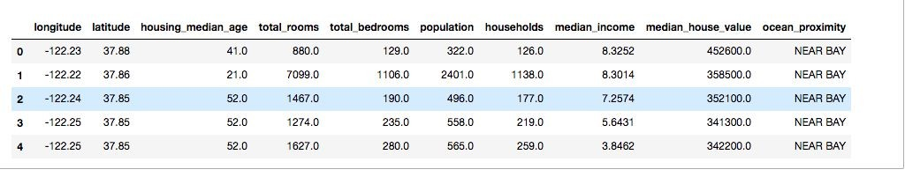

1.

Slide 26


Slide 27
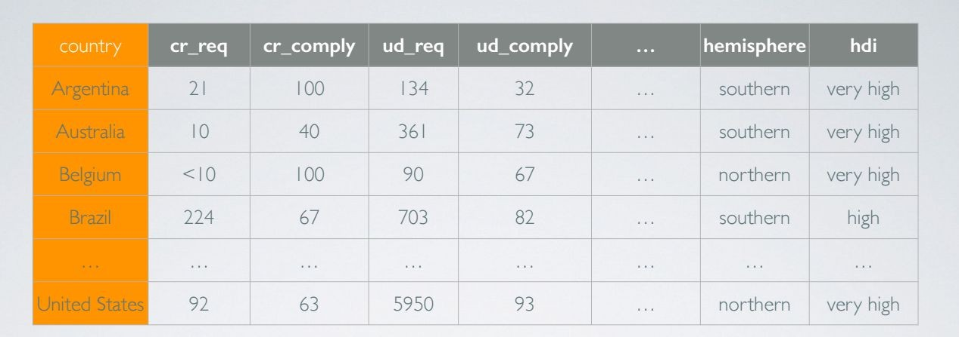



A.

Slide 28



Slide 29




Slide 33


Slide 34


Slide 38



●
○
○
●
●
○
○
○

Slide 39
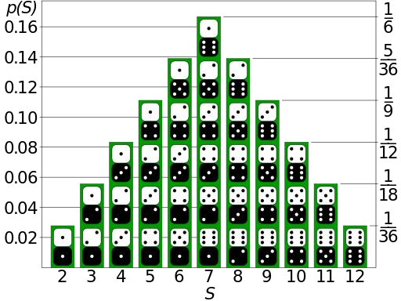
●
○
○

Slide 40

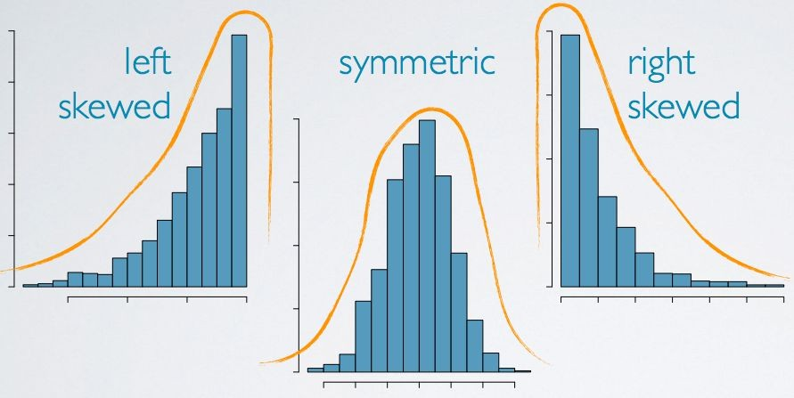

Slide 41

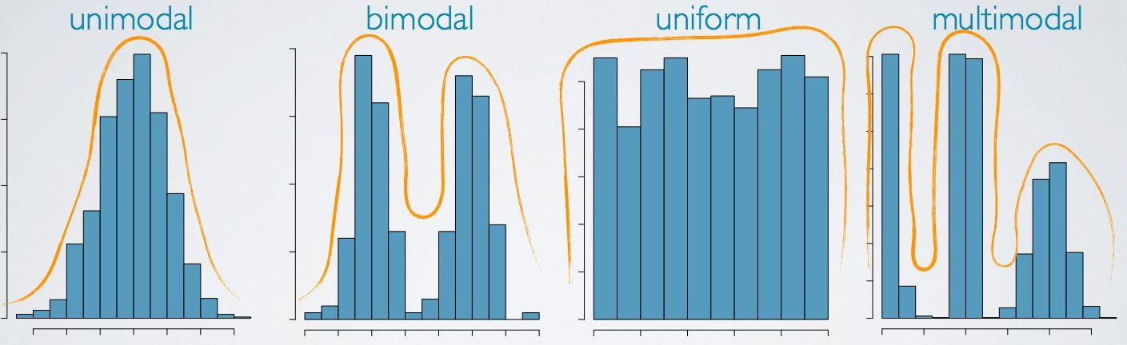

Slide 42
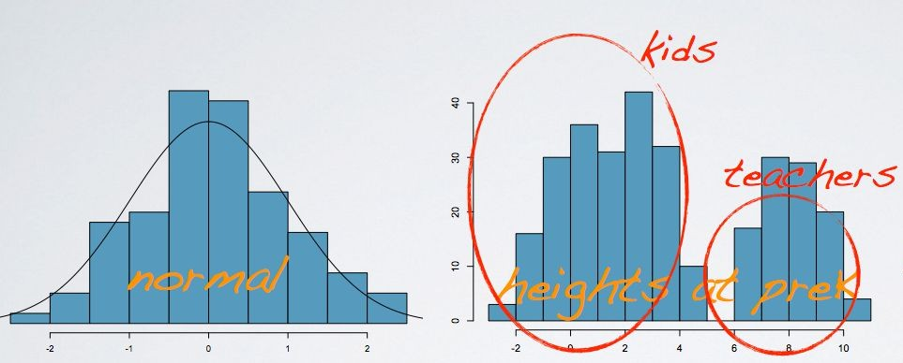
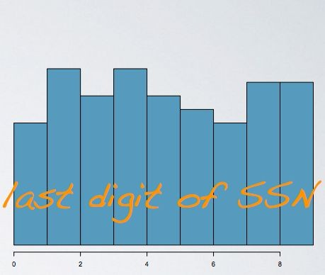
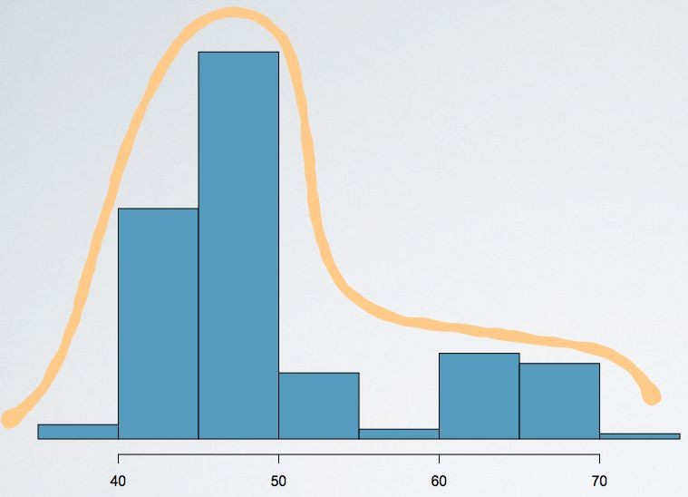

Slide 43
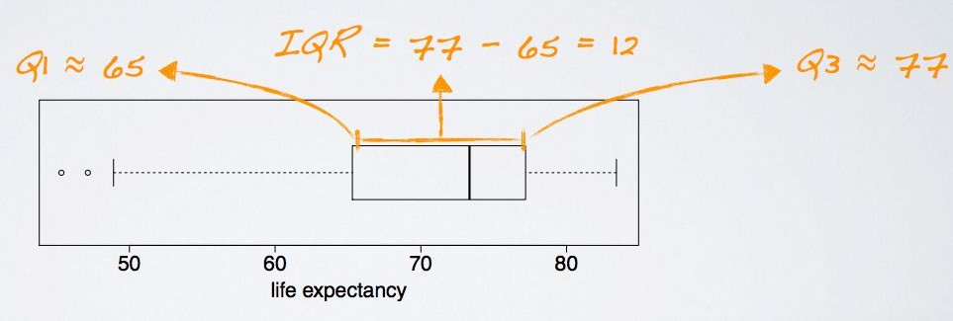

Slide 44

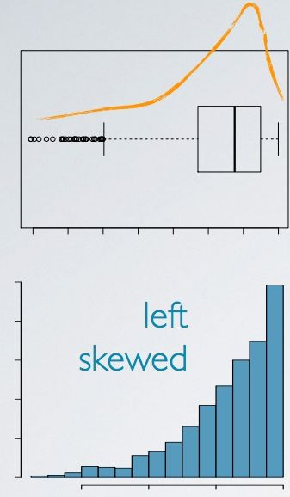
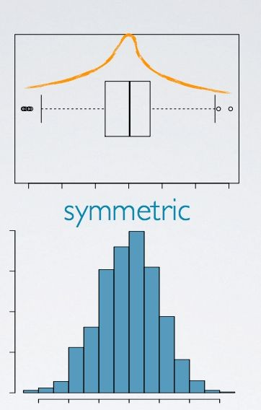
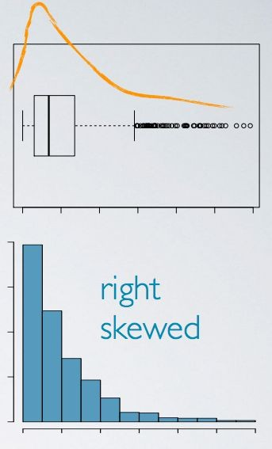

Slide 46
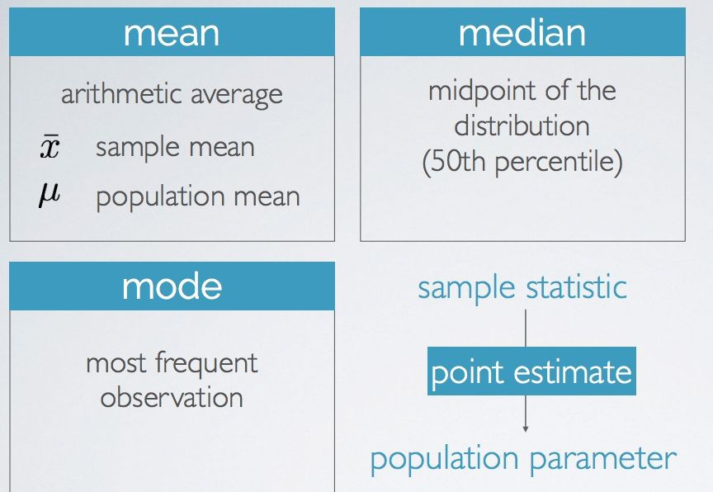

Slide 48
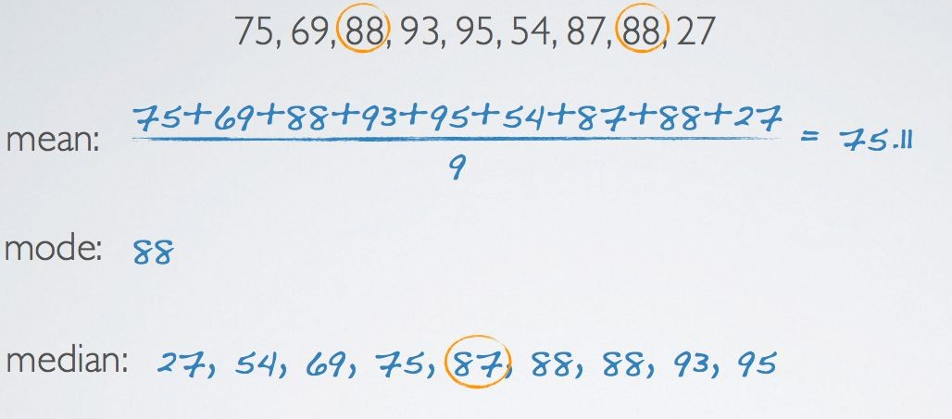

Slide 49

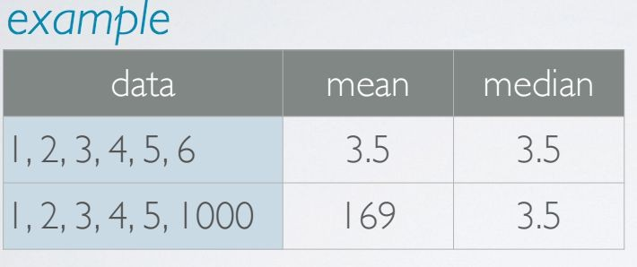
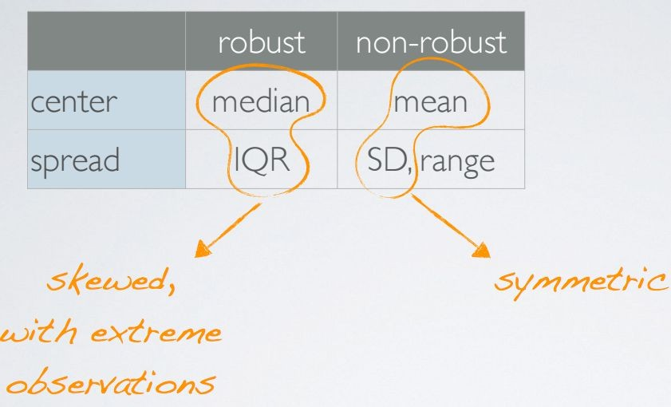

Slide 50
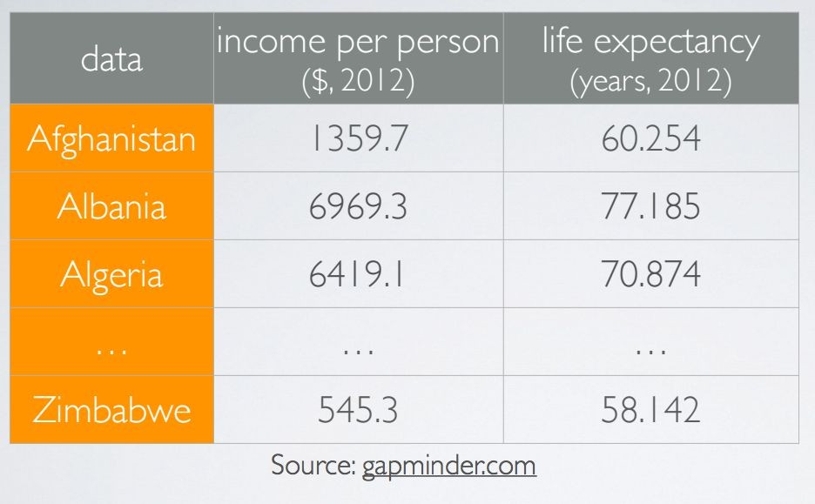

Slide 51
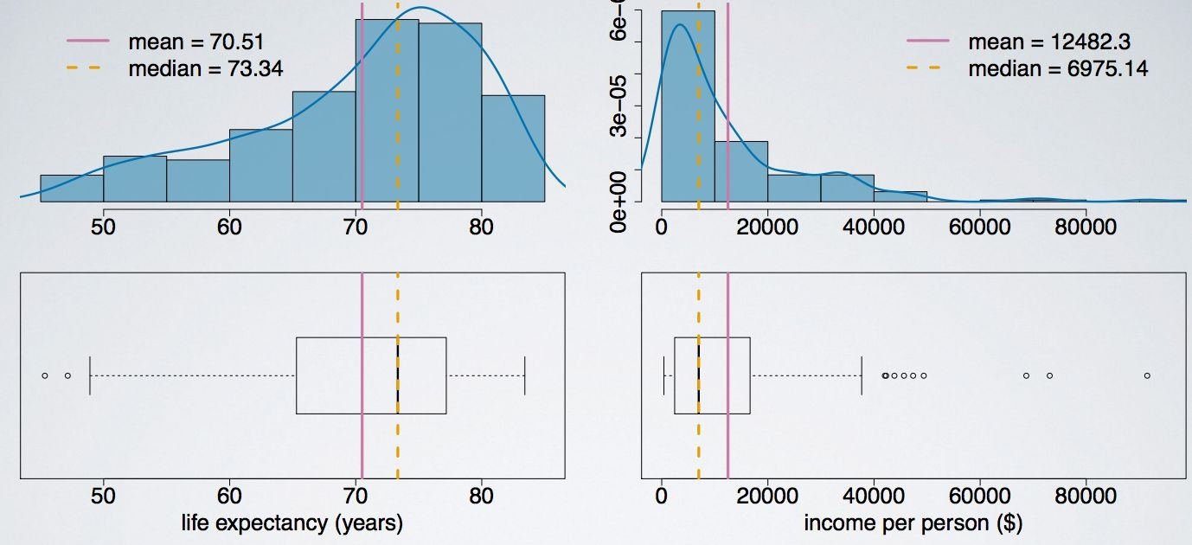

Slide 52
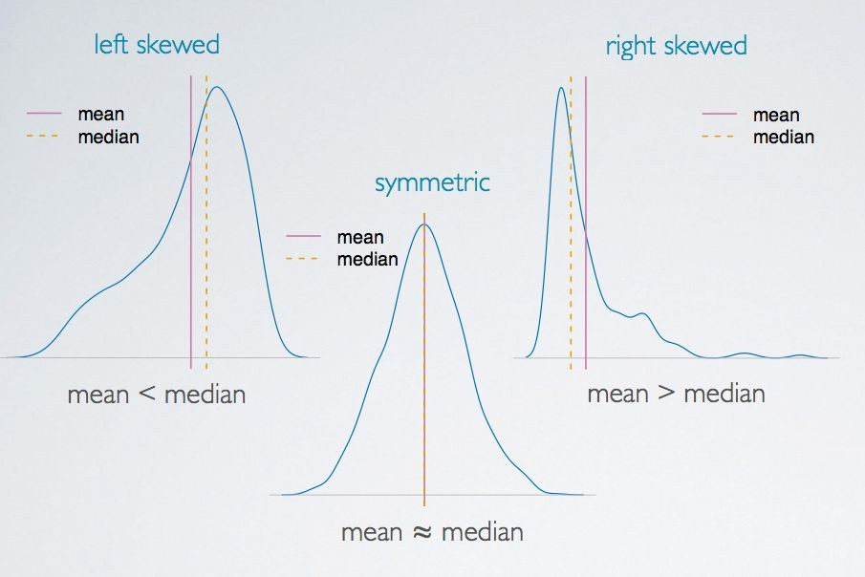

Slide 53


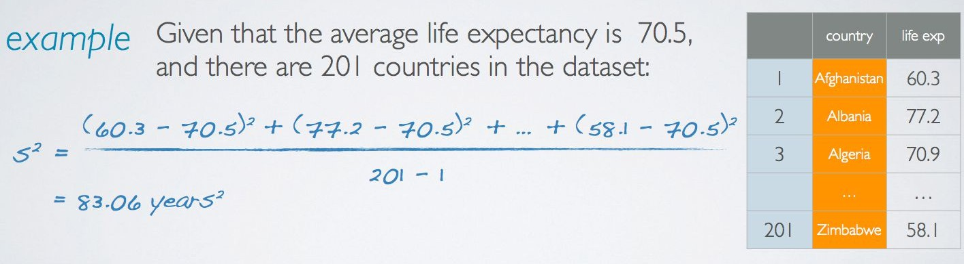

Slide 55
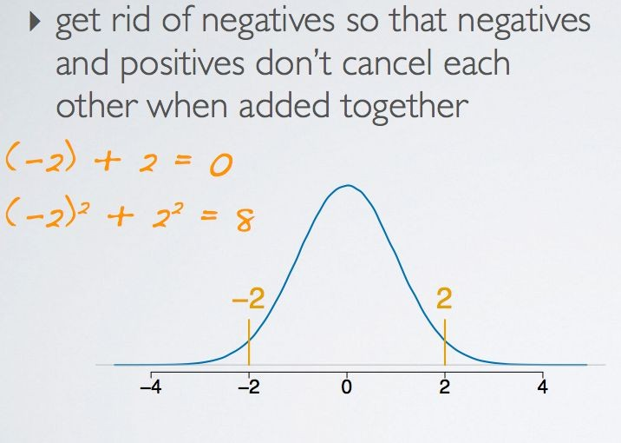

Slide 56
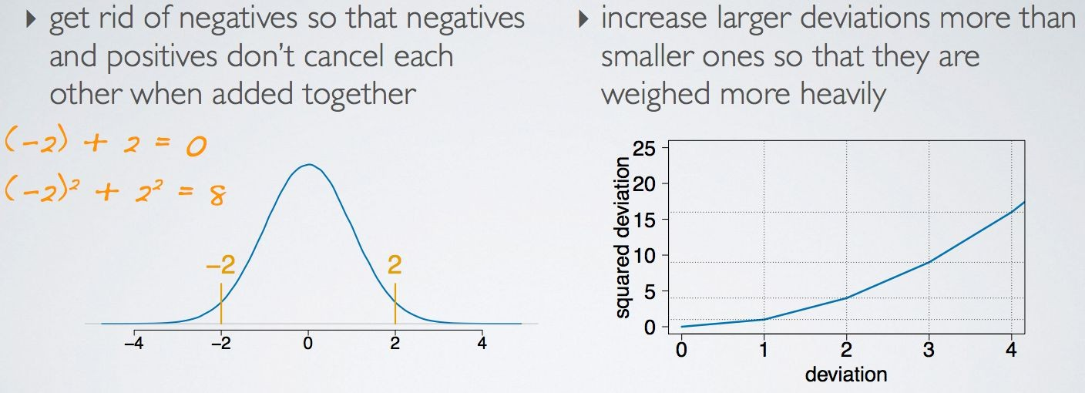

Slide 57
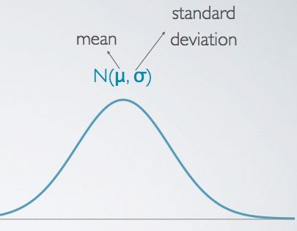

Slide 58
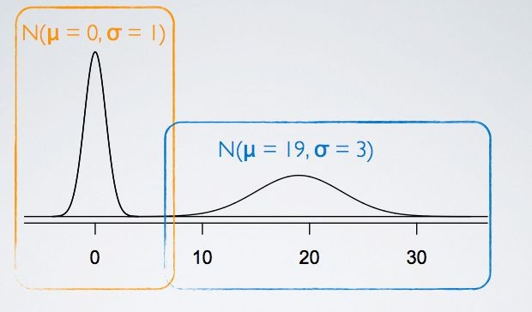
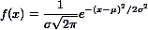

Slide 59
•
•
•
○

Slide 60
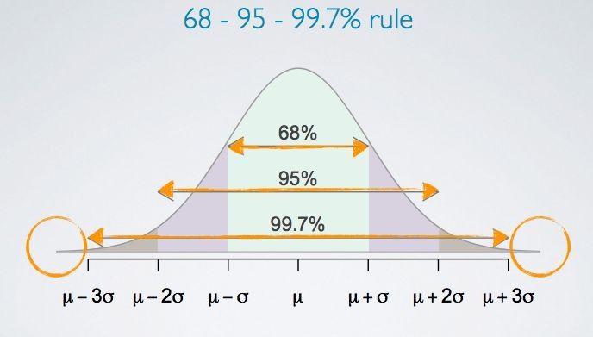

Slide 62
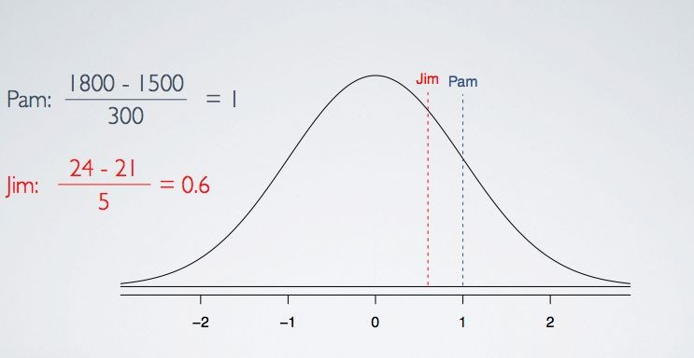

Slide 64
●
●
○

Slide 65








Slide 68
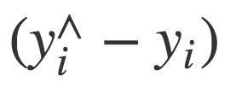

Slide 69

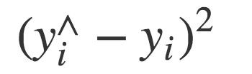

Slide 70

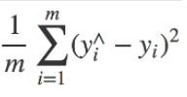

Slide 71
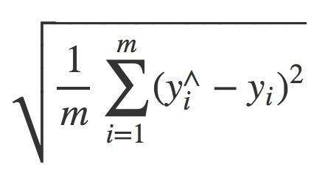

Slide 73


Slide 76

>>> | import | pandas | as | pd
>>> | import | os
>>> HOUSING_PATH = 'datasets/housing/'
>>> def load_housing_data(housing_path=HOUSING_PATH): csv_path = os.path.join(housing_path,
"housing.csv")
return pd.read_csv(csv_path)
>>> housing = load_housing_data()
>>> housing.head()
# Run this in notebook

Slide 77
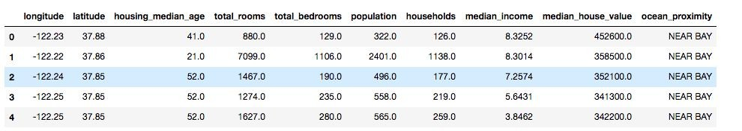

Slide 78







●
●
○
○
○
○
○
○
○
○
○
○

Slide 79


Slide 80

●
●

Slide 81
>>> %matplotlib inline
>>> import matplotlib.pyplot as plt
>>> housing.hist(bins=50, figsize=(20,15))
>>> plt.show()

Slide 82


Slide 83

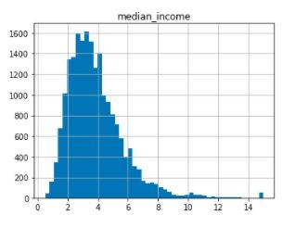

Slide 84



●
●
○
○

Slide 85
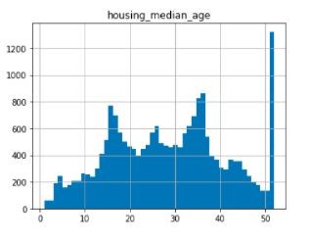
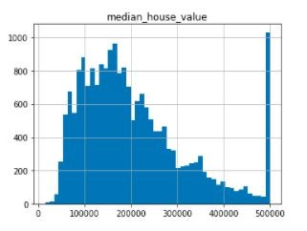

Slide 86


●
○
○
●

Slide 87
●
●
○
○
○

Slide 88
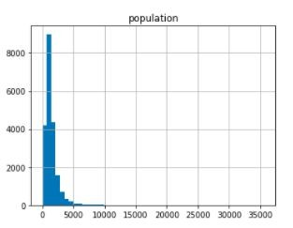
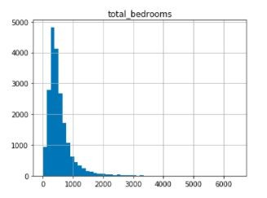

Slide 89
●
●
●

Slide 90
●
○
○
●
●

Slide 91
●
●

Slide 92

●
●
●
●
●
●

Slide 93
●
○
○
train_test_split()
●
○
○

Slide 94
>>> np.random.seed(42)
>>> import numpy as np
def split_train_test(data, test_ratio): shuffled_indices = np.random.permutation(len(data)) test_set_size = int(len(data) * test_ratio) test_indices = shuffled_indices[:test_set_size] train_indices = shuffled_indices[test_set_size:] return data.iloc[train_indices],
data.iloc[test_indices]

Slide 95


np.random.permutation
●
●
○
●
split_train_test
○
○
○

Slide 96
●
●
●
●
split_train_test

Slide 97
split_train_test
>>> train_set, test_set = split_train_test(housing, 0.2)
>>> print(len(train_set), "train +", len(test_set), "test")
16512 train + 4128 test

Slide 98
split_train_test

Slide 100
●
○
○
○

Slide 101
●
●
●
○

Slide 102

●
○
○
○
○

Slide 103

>>> import hashlib
>>> def test_set_check(identifier, test_ratio, hash):
return hash(np.int64(identifier)).digest()[-1] < 256 * test_ratio
>>> def split_train_test_by_id(data, test_ratio, id_column, hash=hashlib.md5):
ids = data[id_column]
in_test_set = ids.apply(lambda id_: test_set_check(id_, test_ratio, hash))
return data.loc[~in_test_set], data.loc[in_test_set]

Slide 104

●
●
>>> housing_with_id = housing.reset_index()
>>> train_set, test_set = split_train_test_by_id(housing_with_id, 0.2, "index")
Run it on Notebook

Slide 106
●
●

Slide 107
●
●

Slide 108
>>> housing_with_id["id"] = housing["longitude"] * 1000
+ housing["latitude"]
>>> train_set, test_set = split_train_test_by_id(housing_with_id, 0.2, "id")
Run it in Notebook

Slide 109




●
○
○
○
○
○

Slide 110
>>> from sklearn.model_selection import train_test_split
>>> train_set, test_set = train_test_split(housing, test_size=0.2, random_state=42)
Run it in notebook

Slide 111


●
●
○
○

Slide 112

●

Slide 113
●

Slide 115






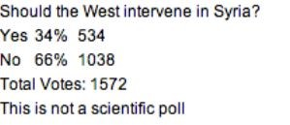

Slide 116
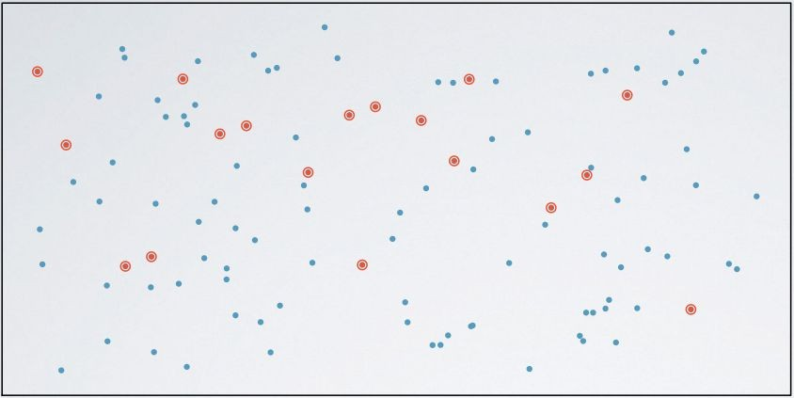
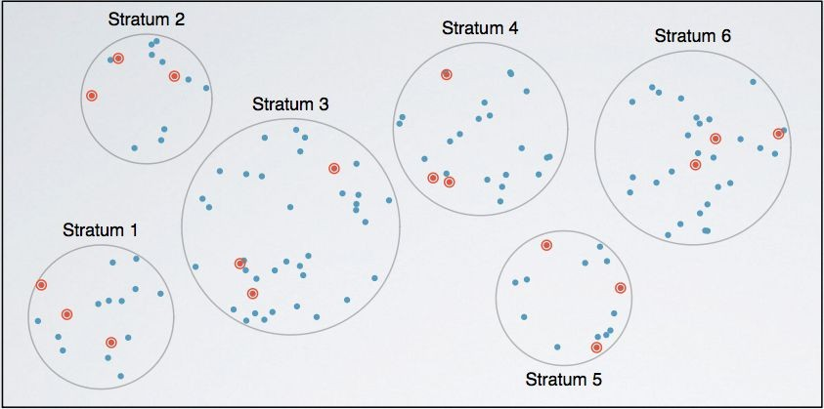

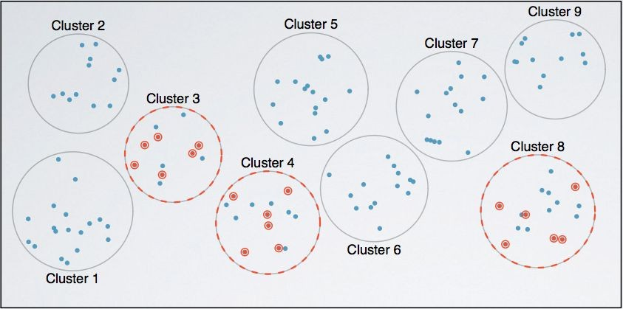


Slide 117


●
○
○

Slide 118


●
○
○
○
●

Slide 119

●
○
●
○
●

Slide 120

●
○
●
○

Slide 121
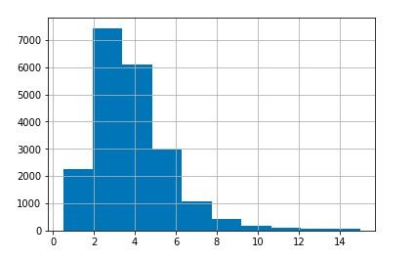
>>> housing["median_income"].hist()

Slide 122


Slide 123
●

Slide 124
●

Slide 125


●
●
○
●
○
○

Slide 127

●
○
○

Slide 128
>>> housing["income_cat"] = np.ceil(housing["median_income"] / 1.5)
>>> housing["income_cat"].where(housing["income_cat"] < 5, 5.0, inplace=True)

Slide 129
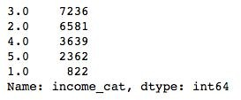


>>> housing["income_cat"].value_counts()

Slide 130
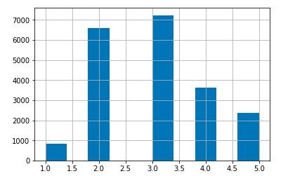
>>> housing["income_cat"].hist()

Slide 131

●
●

Slide 132
>>> from sklearn.model_selection import StratifiedShuffleSplit
>>> split = StratifiedShuffleSplit(n_splits=1, test_size=0.2, random_state=42)
>>> for train_index, test_index in split.split(housing, housing["income_cat"]): strat_train_set = housing.loc[train_index]
strat_test_set = housing.loc[test_index]
Run it in notebook

Slide 134
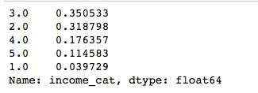
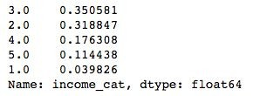
>>>
strat_test_set["income_cat"].value
_counts() / len(strat_test_set)
>>>
housing["income_cat"].value_counts () / len(housing)

Slide 137
>>> def income_cat_proportions(data):
return data["income_cat"].value_counts() / len(data)
>>> train_set, test_set = train_test_split(housing, test_size=0.2, random_state=42)
>>> compare_props = pd.DataFrame({
"Overall": income_cat_proportions(housing), "Stratified": income_cat_proportions(strat_test_set), "Random": income_cat_proportions(test_set),
}).sort_index()
>>> compare_props["Rand. %error"] = 100 * compare_props["Random"] /
>>> compare_props["Overall"] - 100
>>> compare_props["Strat. %error"] = 100 * compare_props["Stratified"]
/ compare_props["Overall"] - 100

Slide 138
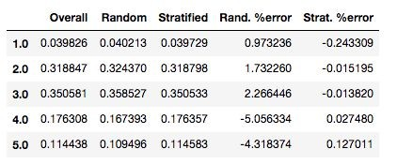

Slide 139


Slide 140

●

Slide 141

●

Slide 142


Slide 143


Slide 144
●
>>> for set in (strat_train_set, strat_test_set): set.drop(["income_cat"], axis=1, inplace=True)
Run in Notebook

Slide 145


Slide 146
●
●

Slide 148

●
●
○
○

Slide 149


●
○
○
●
○

Slide 150
●
●
>>> housing = strat_train_set.copy()
Run it on Notebook

Slide 151
●
●
>>> housing.plot(kind="scatter", x="longitude", y="latitude")
Run it on Notebook

Slide 152


Slide 153
●
●

Slide 154
●
●
>>> housing.plot(kind="scatter", x="longitude", y="latitude", alpha=0.1)

Slide 155








Slide 156
>>> housing.plot(kind="scatter", x="longitude", y="latitude", alpha=0.4,
s=housing["population"]/100, label="population", figsize=(10,7),
c="median_house_value", cmap=plt.get_cmap("jet"), colorbar=True,
sharex=False)
>>> plt.legend()

Slide 157


●
●
●
○
○
○

Slide 158


Slide 159


Slide 160


Slide 161



●
○
○

Slide 162

●

Slide 164
●
●

Slide 165
●
○

Slide 166


Slide 167


Slide 168


Slide 169


Slide 170
●
●
●
●
corr()

Slide 171
>>> corr_matrix = housing.corr()
>>>
corr_matrix["median_house_value"].sort_values(ascending= False)
Run it in Notebook

Slide 172


Slide 174

●
○
○
scatter_matrix

Slide 175

●
○
○

Slide 176



○
○
○
○
●

Slide 177
>>> from pandas.tools.plotting import scatter_matrix
>>> attributes = ["median_house_value", "median_income", "total_rooms", "housing_median_age"]
>>> scatter_matrix(housing[attributes], figsize=(12, 8))
Run it in Notebook

Slide 178


Slide 181


Slide 182
●
>>> housing.plot(kind="scatter", x="median_income", y="median_house_value", alpha=0.1)
>>> plt.axis([0, 16, 0, 550000])
Run it in Notebook

Slide 183


Slide 184


Slide 189




●
○
○
●
○
○

Slide 190
●
●

Slide 191
●
●
●
○

Slide 192


●
○
○

Slide 193

●
●
●

Slide 194

●
○

Slide 195
●
>>> housing["rooms_per_household"] = housing["total_rooms"]/housing["households"]
>>> housing["bedrooms_per_room"] = housing["total_bedrooms"]/housing["total_rooms"]
>>>
housing["population_per_household"]=housing["population"
]/housing["households"]
Run it in Notebook

Slide 196
●
>>> corr_matrix = housing.corr()
>>>
corr_matrix["median_house_value"].sort_values(ascending= False)
Run it in Notebook

Slide 197


Slide 200


